Slide 1
FOR EACH

Slide 2
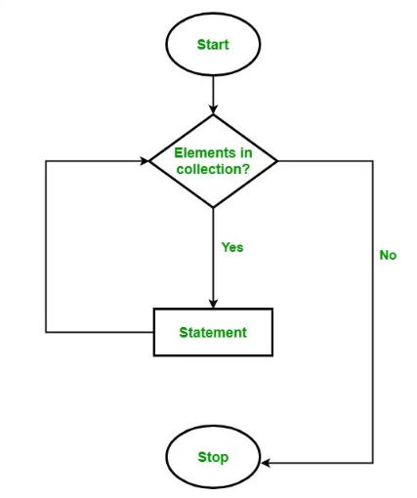
What is a Foreach Loop
Looping is a way to execute a statement(s) multiple times depending on the result of a condition. As long the given condition satisfies the loop executes. Once the condition failed, the loop terminates.
The Foreach Loop in C# is a different kind of loop that doesn’t include initialization, termination, and increment/decrement characteristics. It uses the collection to take values one by one and then processes them.
The foreach loop in C# is used to iterate over the elements of a collection. Here, the collection may be an array or a list or a dictionary, etc. As per the name i.e. foreach, it executes the loop body for each element present in the array or collection.
In C#, the foreach loop iterates collection types such as Array, ArrayList, List, Hashtable, Dictionary, etc. It can be used with any type that implements the IEnumerable interface.

Slide 3
Limitation of ForEach
1. The Foreach loop in C# is not appropriate when we want to modify the array or collection.
foreach(int item in collection)
{
// only changes item variable not the collection element
item = item + 2;
}
2. The Foreach loop in C# does not keep track of indexes. So, it is not possible to get the array index or collection index using the Foreach loop
foreach (int item in collection)
{
if item == target)
{
return ???; // do not know the index of the item
}
}
3. The Foreach loop in C# only iterates forward direction. The following forloop cannot be converted to a foreach loop as we are starting from the last element
for (int i = numbers.Length – 1; i > 0; i–)
{
Console.WriteLine(numbers[i]);
}

Slide 4
Difference between For Loop and Foreach Loop:
The for loop in C# executes a statement or a block of statements as long as the given condition is true. Whereas foreach loop executes a statement or a block of statements for each element present in the array or collection and there is no need to define the minimum or maximum limit.
In for loop, it is possible to iterate the array elements in both forward and backward directions, e.g from index 0 to 9 and from index 9 to 0. But in the foreach loop, it is only possible to iterate an array in the forward direction, backward direction is not possible

Slide 5
Points to Remember while working with Foreach Loop
The foreach loop in C# iterates only in the forward direction. Backward direction is not possible.
From the Performance point of view, the foreach loop takes more time as compared with for loop. Because internally it uses extra memory space.
The foreach loop use GetEnumarator() method of the IEnumerable interface. So, the foreach loop can be used with any class that has implemented the interface.
We Can exit the foreach loop in C# by using break, return, Goto and throw statements..

